Slide 1
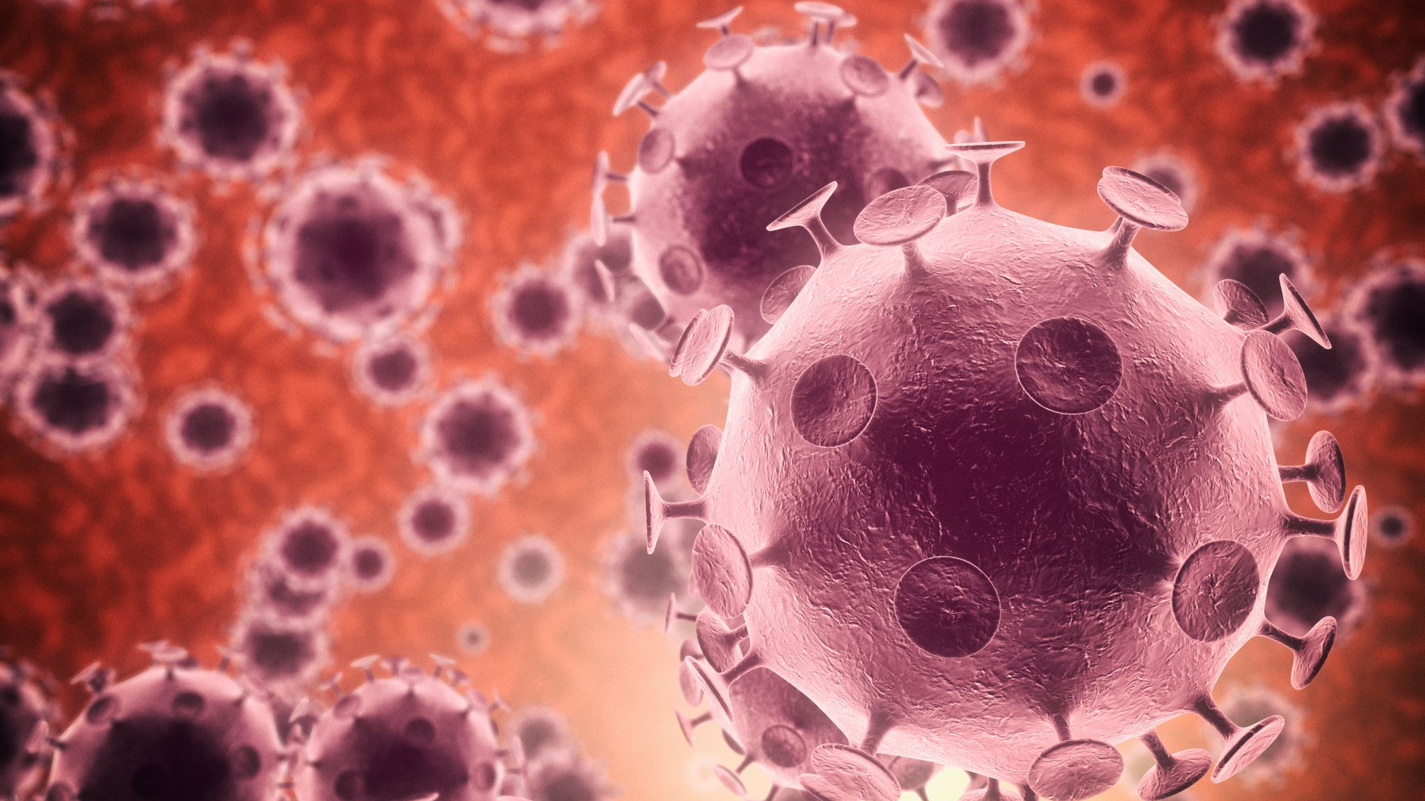
Pathogens and Introduction to viruses Updated by Ms Rayner 2022

Slide 2
Syllabus:
The major groups of organisms that cause disease are bacteria, fungi, protists and viruses; each group can be distinguished by its structural characteristics
The life cycle of a pathogen and its associated diseases, including the method of invading the host, the impact on the host, and the mode of transmission (direct or indirect), determines its success for survival
Describe the structure of a virus
Describe the life cycle of a pathogen
Describe the different modes of transmission of pathogens
Essential
Question:

Slide 3
What you need to complete
Biozone
74 Infection & Disease
75 Transmission of Disease
Biology WA UNITS 3 & 4
Reading
Chapter 12 – pages 407 – 413
Chapter 13 – pages 431 – 435
Question Sets
12.1a, 12.1b, 12.2, 13.1 and 13.2

Slide 4
Pathogens Life Cycle

Slide 5
Recap: Define the term pathogen and state the four groups of pathogens that can cause disease

Slide 6
Topic Question 1: Describe the main features of a pathogens life cycle
This cycle is known as a pathogen’s life cycle. Some pathogens have developed elaborate life cycles that enable them to survive, reproduce and spread.
Infected host reservoir
Site for replication of infectious agent
Portal of exit
Some infectious diseases have another possible reservoir
Mode of transmission
Portal of entry
Susceptible host

Slide 7
Topic Question 2: State the ways pathogens can leave a hosts body and how they can enter a susceptible hosts body
Portals of entry | Portals of exit
•Skin (bite, blood feed, penetration) •Mucous membranes •Wounds in epidermal layers of animals and plants •Eyes and ears •Respiratory system/nose/throat/lungs | •Bite/blood feed/saliva •Digestion (elimination) •Respiratory system (coughing, sneezing) •Blood contact •Reproductive system (some honeybee viruses pass from queen bee to worker bees)
Biology WA Units 3 & 4
Set 13.1 pg.432 Q 1-5

Slide 8
Recap: Define the term transmission and the two modes of transmission
Transmission is how the pathogen is transferred from the host and/or a reservoir to a susceptible host, which can involve developmental stages occurring in the
environment or in vectors.
Vectors are living or non-living things that transport pathogens from the
infected host to a susceptible host. Mosquito vectors transport pathogens through blood feeds. Bat vectors transport pathogens through bites and scratches.
The different modes of transmission are commonly classified as direct or indirect. Direct transmission is the transfer of a pathogen from an infected host, or other reservoir, to a susceptible host by direct contact or droplet spread.
Indirect transmission is the transfer of a pathogen from a reservoir to a host through vectors (inanimate vehicles as well as living intermediaries) or suspended air particles.

Slide 9
Recap: Describe the different ways diseases can be transmitted by direct transmission
Direct transmission
Direct contact
Transmission due to physical touch between an infected host and a susceptible host via skin/body fluids
ABL via infected bat
Influenza
Close contact
Transmission of pathogen in airborne droplets between an infected host and a susceptible host, such as sneezing/coughing within 1 metre or due to close proximity
Influenza
Reservoir (other)
Transmission from an inanimate reservoir/fomite to a susceptible host. A reservoir could be soil, as for tetanus bacteria.
Tetanus
Influenza (fomite)

Slide 10
Recap: Describe the different ways diseases can be transmitted by indirect transmission
Vectors are living or non-living things that transport pathogens from the infected host to a susceptible host. Mosquito vectors transport pathogens through blood feeds. Bat vectors transport pathogens through bites and scratches.
Indirect transmission
Vector
A living thing that transmits a pathogen from an infected host to a susceptible host. Bats and mosquitoes are vectors.
Tetanus via dog-bite saliva
Honeybee viruses via varroa mite
ABL via healthy carrier bat
Ross River disease
Malaria

Slide 11
Recap: Describe the different ways diseases can be transmitted by indirect transmission
Indirect transmission
Soilborne/ waterborne/foodborne and vehicle or fomite
An inanimate object (fomite) acts as an intermediary between the portal of exit from the reservoir and the portal of entry to the host. For example, car tyres and human shoes can carry pathogens from a contaminated area to an area containing susceptible hosts.
Pathogens can swim or be carried through water or wet soil from an infected host to a susceptible host.
Contaminated food (note none of the diseases studies are transmitted this way)
Crown gall can enter via a wound
Chytridiomycosis
Phytophthora
Biology WA Units 3 & 4
Set 13.2 pg.432 Q 1-5

Slide 12
Recap: State the pathogens that cause the 10 diseases
Pathogen classification | Diseases
Virus | Influenza | Ross River disease/fever | Viral diseases of honeybees | Australian bat lyssavirus
Bacteria | Tuberculosis (TB) | Tetanus | Crown gall of plants
Fungus | Chytridiomycosis (amphibian chytrid fungus disease) (caused by fungi)
Protist | Malaria | Phytophthora dieback (jarrah dieback)*
*The Phylum Oomycota containing Phytophthora dieback has been removed from the Fungi Kingdom and placed in the Protista Kingdom

Slide 13
Pathogen - Viruses

Slide 14
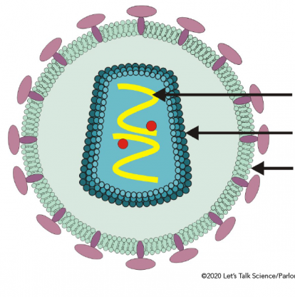
Topic Question 3: Label the bacteriophage and the enveloped virus

Slide 15
Topic Question 4: List structural features of viruses
Virus structural features
DNA or RNA enclosed within a capsid or protein coat
Nucleic acid, either DNA or RNA
No organelles, no metabolic machinery, metabolically inert
Very small. 30 - 300 nanometres in length
have proteins that can recognise and bind to receptors on host cell

Slide 16
Topic Question 5: Explain why a virus can be described as a non-cellular pathogen
Viruses are non-cellular pathogens.
Viruses consist of one or more strands of nucleic acid (RNA or DNA) inside a protein coat.
They maintain this structure during the inert phase of their life cycle; that is, when they are not inside a host.
Viruses are NOT made out of cells and therefore are non-living.
They possess no metabolic machinery for processes such as cellular respiration.
Viruses cannot be classified as prokaryotes or eukaryotes, because they are non-cellular.
Instead of cellular features such as ribosomes and mitochondria, they have some nucleic acid and a protective coat.

Slide 17
Topic Question 6: Describe why a pathogen can be said to be an obligate parasite
A virus is often referred to as an obligate parasite
An obligate parasite is an organism that can only survive inside another organism
A virus does not have any metabolic machinery, it is metabolically inert. Meaning it can not grow or reproduce outside of a host cell, therefore a virus must enter a cell to perform these processes

Slide 18
Topic Question 7: Using a clearly labelled diagram describe how an enveloped virus replicates within a host eukaryotic cell

Slide 19
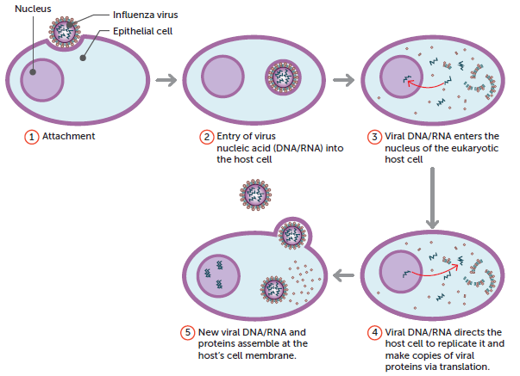
Topic Question 7: Using a clearly labelled diagram describe how an enveloped virus replicates within a host eukaryotic cell

Slide 20
Topic Question 7: Using a clearly labelled diagram describe how a bacteriophage replicates within a host bacterial cell
Biology WA Units 3 & 4
Set 12.2 pg.413 Q 1-8

